Slide 1
Software Architecture
Design Principles – OCP & LSP

Slide 2
Content
The Open-Closed Principle (OCP)
The Liskov Substitution Principle (LSP)
Software Systems Architecture
Xiaobin Xu

Slide 3

OCP – An example of violating OCP
If the client has a reference to a concrete server-class, replacing the server leads to modification of the client.
Software Systems Architecture
Xiaobin Xu

Slide 4
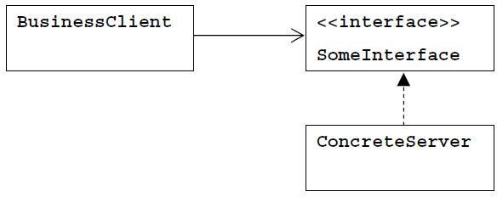
OCP – Conforming to OCP
If the client has a reference to an interface, replacing the server will not lead to modification of the client. The client still references the interface.
Software Systems Architecture
Xiaobin Xu

Slide 5
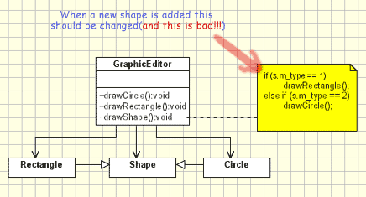
Example 2
Software Systems Architecture
Xiaobin Xu

Slide 6
Example 2
// Open-Close Principle - Bad example
class GraphicEditor {
public void drawShape(Shape s) { if (s.m_type==1) drawRectangle(s);
else if (s.m_type==2)
drawCircle(s);
}
public void drawCircle(Circle r) {....}
public void drawRectangle(Rectangle r) {....}
}
Software Systems Architecture
Xiaobin Xu

Slide 7
Example 2
// Open-Close Principle - Good example class GraphicEditor {
public void drawShape(Shape s) { s.draw();
}
}
class Shape {
abstract void draw();
}
class Rectangle extends Shape {
public void draw() { // draw the rectangle }
}

Slide 8
OCP
Conforms to the OCP
To add a new shape:
Open for extension – Add new subclass for new shape
Closed for modification – No mod. In drawShape()
What about the smells?
Rigidity – Just add new shape-classes
Fragility – No if’s or switches to maintain
Opacity, Needless Repetition, Immobility, … No problem!
The code is closed against this particular change
Software Systems Architecture
Xiaobin Xu

Slide 9
OCP – Shape may have more issues
What if a new requirement states that the
shapes must be drawn in some sorted order, e.g. all Circles must be drawn before all Squares:
No matter how “closed” a module is, there will always be some kind of change against which it is not closed.
The designer must choose the kinds of changes against which to close his design. Which changes are more likely?
Plan for OCP, but wait until the change happens!
To avoid needless complexity, take the first bullet.
Software Systems Architecture
Xiaobin Xu

Slide 10
Stimulate the changes
Stimulate the changes
Write tests first.
Use short developing cycles
Develop features before infrastructure and frequently show those features to stakeholders.
Develop the most important features first.
Release the software early and often.
Software Systems Architecture
Xiaobin Xu

Slide 11
OCP - Summary
Principle: Software entities should be
Open for extension – new functions are added
Closed for modification – existing code is unchanged
Implementation:
Find an abstraction for what is common in the variation
Use polymorphism to add varying behavior
Abstractions can also be applied in non-OO languages!
Software Systems Architecture
Xiaobin Xu

Slide 12
OCP - Summary
OCP cannot be achieved for all possible
contexts!
Strategic choices
Apply only for actual changes
Software Systems Architecture
Xiaobin Xu

Slide 13
LSP - Liskov Substitution Principle
The key of OCP: Abstraction and Polymorphism
Implemented by inheritance
How do we measure the quality of
inheritance?
If for each object ob1 of type S there is an object ob2 of type T such that for all programs P defined in terms of T, the behavior of P is unchanged when ob1 is substituted for ob2 then S is a subtype of
T. B. Liskov, 1988
Software Systems Architecture Xiaobin Xu

Slide 14
LSP - Liskov Substitution Principle
LSP: Subtypes must be substitutable for their base types.
Software Systems Architecture
Xiaobin Xu

Slide 15
Example
class Rectangle {
protected int m_width;
protected int m_height;
public void setWidth(int width){ m_width = width; }
public void setHeight(int height){ m_height = height; }
public int getWidth(){ return m_width; } public int getHeight(){ return m_height; }
public int getArea(){ return m_width * m_height; }
}

Slide 16
Example
class Square extends Rectangle {
public void setWidth(int width){ m_width = width; m_height = width;
}
public void setHeight(int height){ m_width = height;
m_height = height;
}
Rectangle
Square
}
Software Systems Architecture
Xiaobin Xu

Slide 17
Example
class LspTest {
private static Rectangle getNewRectangle() {
// it can be an object returned by some factory ... return new Square(); }
public static void main (String args[]) { Rectangle r = LspTest.getNewRectangle(); r.setWidth(5);
r.setHeight(10);
// user knows that r it's a rectangle. System.out.println(r.getArea());
// now he's surprised to see that the area is 100 instead of //50.
}
}

Slide 18
LSP Conclusion
Conclusion:
A model, viewed in isolation, can’t be meaningfully validated.
ISA is about behavior.
Behaviorally, a square is not a rectangle.
Software Systems Architecture
Xiaobin Xu

Slide 19
Exercise
Please give an example that violates LSP and explain why? How to modify it to conform to LSP?
Software Systems Architecture
Xiaobin Xu

